Slide 1

Janakpur Railway Reservation System
BY -
Nikesh Baral (23)
Norgen Moktan (24)
Prabas Pokhrel (25)
TO -
Department of Electronics & Computer Engineering

Slide 2
Introduction
This is a C Program that is basically concerned with the reservation of railway tickets to the passengers.
In this we are discussing that how the reservation is done with the feature of cancelling and waiting list.
In the project we are going to include entities like
Reservation
Cancellation
Display reserved and waiting list passengers.
Notes:
‹#›

Slide 3
OBJECTIVE OF THE PROJECT
All the manual work should be converted into computerized so that the load of employees should decrease.
The data should be stored in computer rather than in register manually.
Booking can be done by sitting at your home only, no need to visit the booking counter.
Notes:
‹#›

Slide 4
Singly Linked List
Data Structure
Linked List is a sequential collection of nodes.Which is faster than array in terms of deletion of nodes. It’s memory is dynamically allocated in runtime. This saves time and space.
Each node consists of four different data field :
#Name
#Age
#Registration Number
#Link to the next node

Slide 5
Queue
Queue is a data structure in which insertion and deletion takes place from the ends. It follows First In First Out Principle.
Queue data structure is used here to store the waiting list passengers. If anyone cancels their ticket then that seat is allocated to the first passenger in the queue.

Slide 6
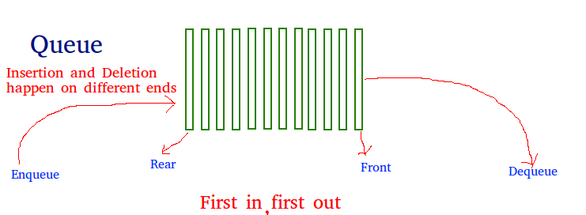
Linear Queue
A Queue is a linear structure which follows a particular order in which the operations are performed. The order is First In First Out (FIFO) .In a queue, we remove the item the least recently added.

Slide 7
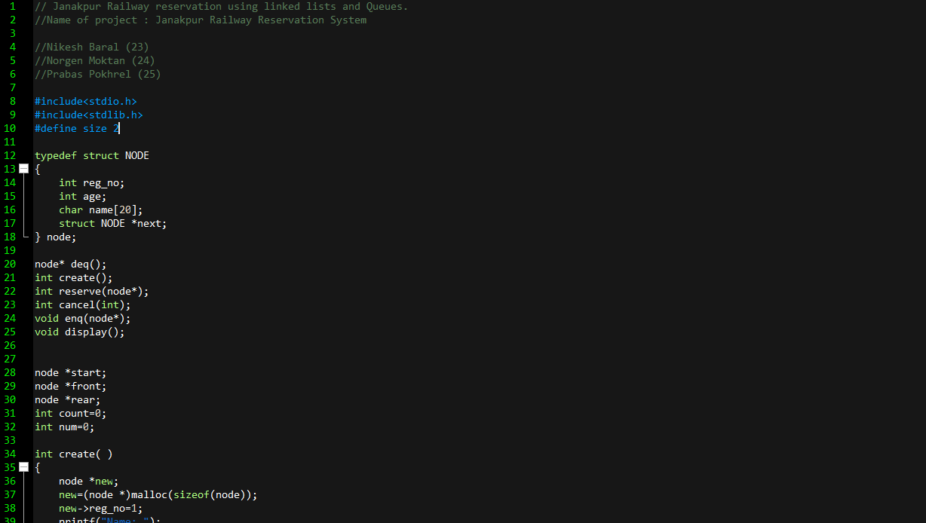
Source Code Of Our Project
(Janakpur Railway Reservation System)

Slide 8
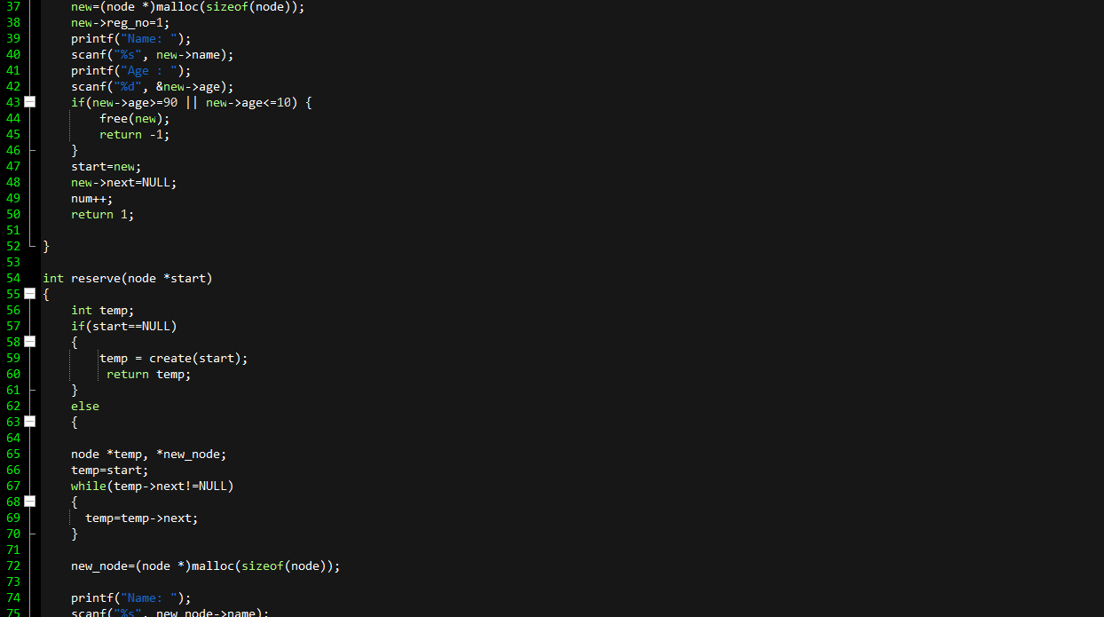

Slide 9
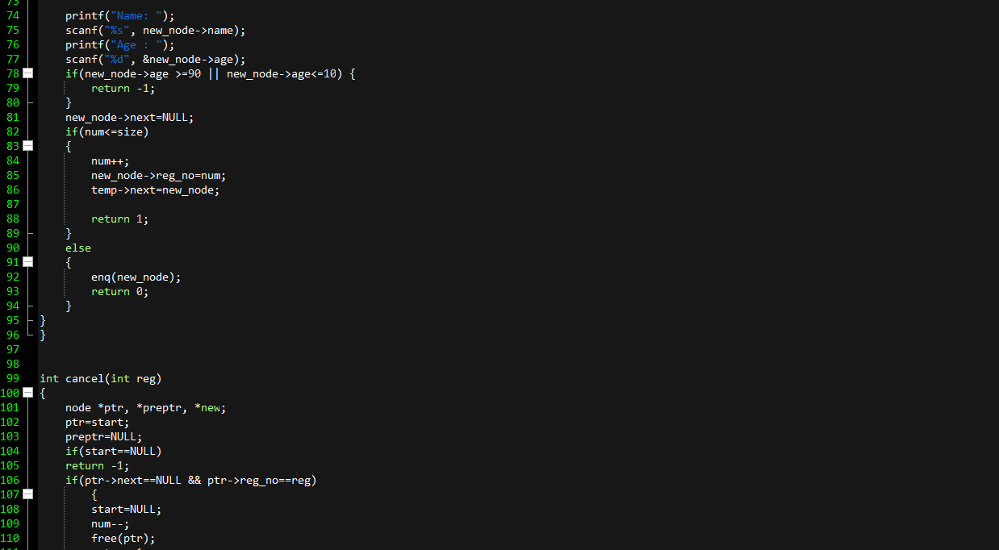

Slide 10
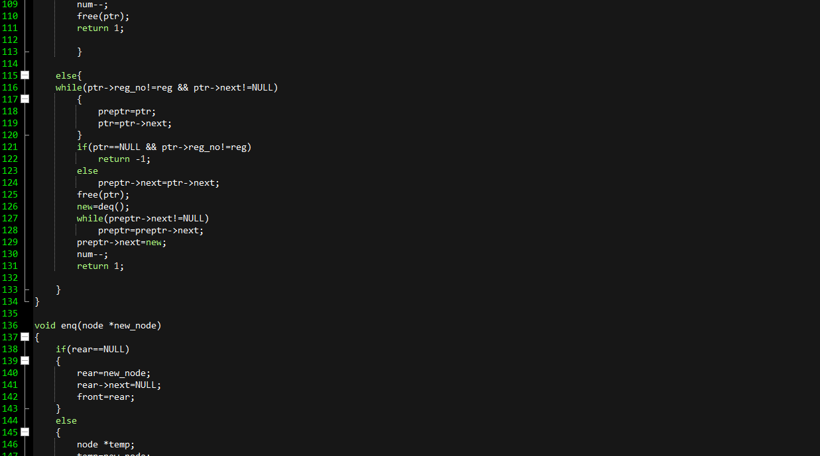

Slide 11
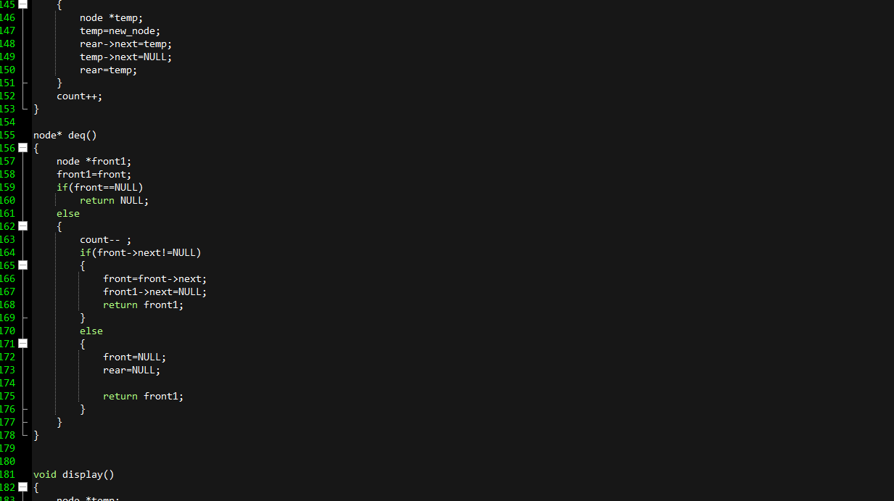

Slide 12
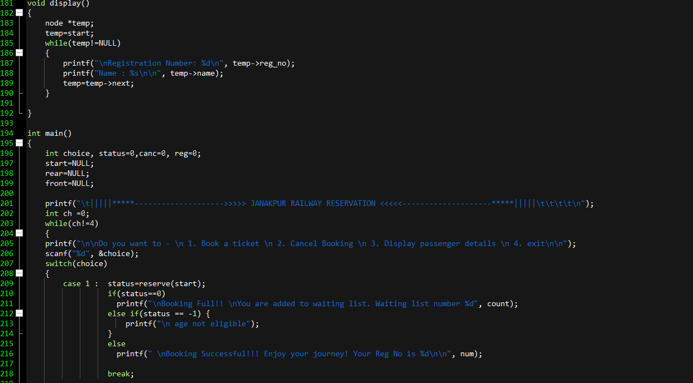

Slide 13
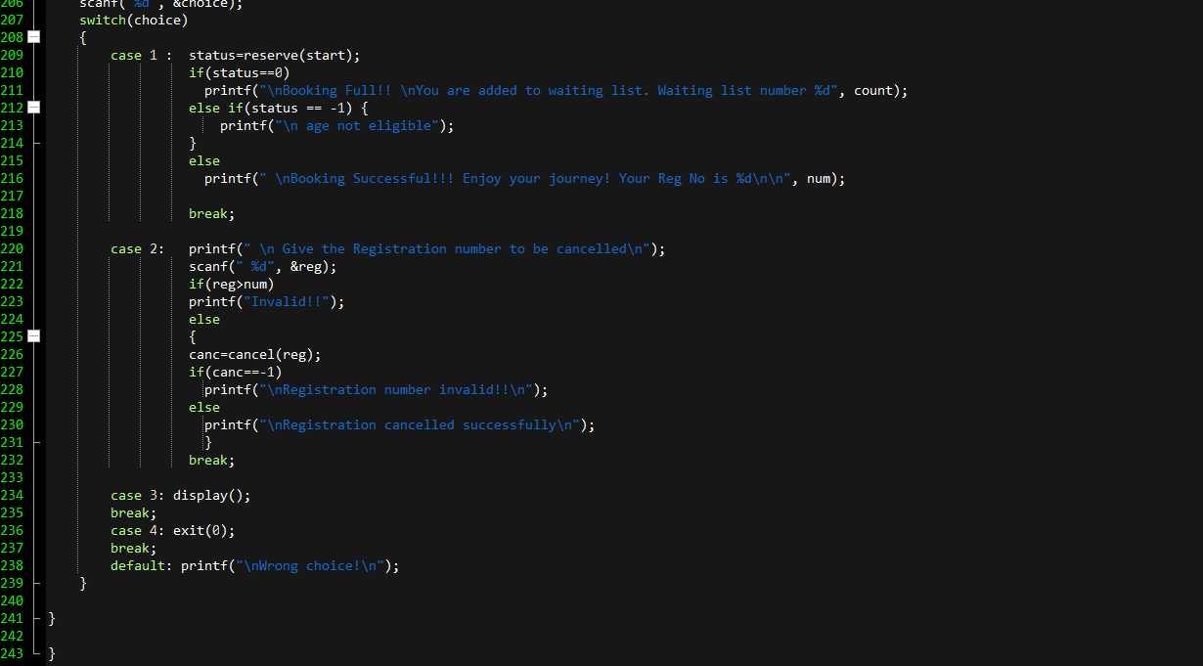

Slide 14
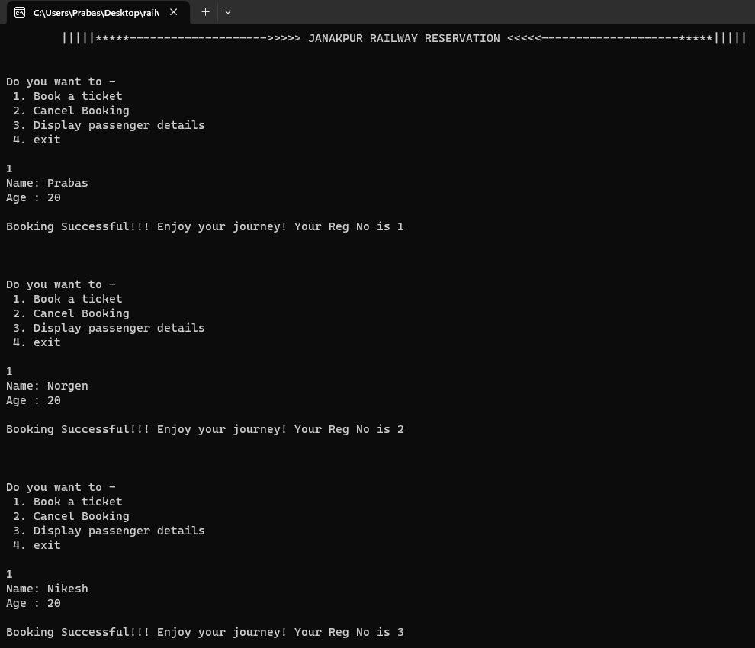
Results
For
Booking
Tickets.
Notes:
‹#›

Slide 15
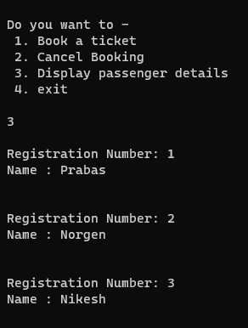
Results
For Displaying
Passengers.

Slide 16
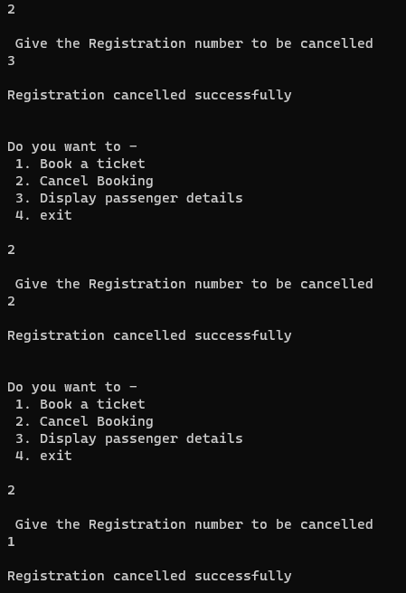
Results
For Cancelling Reservations.

Slide 17
ADVANTAGES
Reduces the burden of traveler waiting in the booking counter.
User-friendly.
Convenient.
Time savings.
Helpful during COVID.

Slide 18
Future Enhancements
We can optimise our time complexity using some different data structure.
We can add features such as prioritising on the basis of age or railway employees and gender.
We can add feature of instant reservation.
We can provide this solution on online portal.

Slide 19
Thank You

